Slide 1

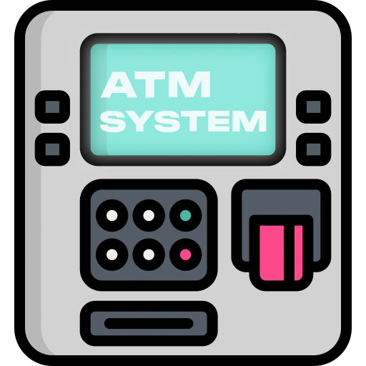
ATM
MANAGEMENT
SYSTEM

Slide 2
OUR Team Member
01
02
03
04
Tunazzinur Rahman
Kabbo
ID: 19202103268
MD. Zobayer Hasan
Nayem
ID: 19202103274
Nayema Khatun
ID: 19202103245
Rubaiatul Jannat
ID: 19202103249

Slide 3
PROJECT REVIEW
Introduction
Problem Definition
Efficiency of this project
System Requirement
Program Feature
Feature Details Advantages
Conclusion

Slide 4
INTRODUCTION
Efficient Management
Proper Money Transfer System
Proper Use of Computer Technology
Opening Bank and Card account instant
Included Crypto-Currency
Details about ATM

Slide 5
PROBLEM DEFINITION
An Automated Teller Machine (ATM) allows customers to perform banking transactions anywhere and at anytime without the need of human teller.
By using a debit or ATM card at an ATM, individuals can withdraw cash from checking or savings accounts, make a deposit or transfer money from one account to another or perform other functions.

Slide 6
DESCRIPTION
An automated teller machine (ATM) or cash machine (in British English) is an electronic telecommunications device that enables customers of financial institutions to perform financial transactions, such as cash withdrawals, deposits, funds transfers, balance inquiries or account information inquiries, at any time and without the need for direct interaction with bank staff.
We also included in our project the international money transfer system, dual currency without passport, CryptoCurrency transactions etc.

Slide 7
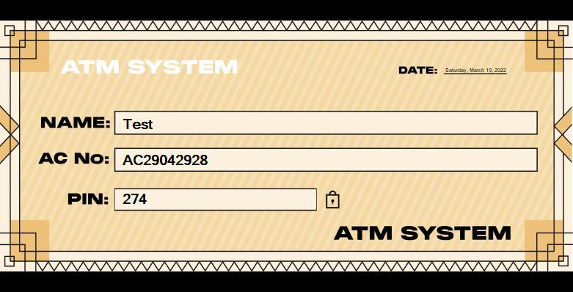
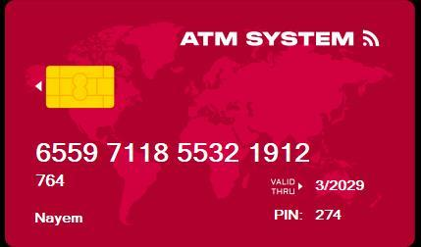
EFFICIENCY OF THIS PROJECT
Anyone can create an account by giving proper information and will get a check (for bank account) and will get a card (for card registration).

Slide 8
HARDWARE REQUIREMENTS
HARDWARE (Minimum Requirement)
Minimum RAM: 1GB or more
Hard Disk: 40 GB or more
Processor: Intel Pentium 3 or above
SOFTWARE (Minimum Requirement)
Operating system: Windows 2000 / 2008 / 2010 / 2020 / XP / Vista
Analyzing Software: Dev C#, Visual Studio, Xampp
Compiler : Standard C#
Compiler Data Composer : Microsoft Office Program

Slide 9
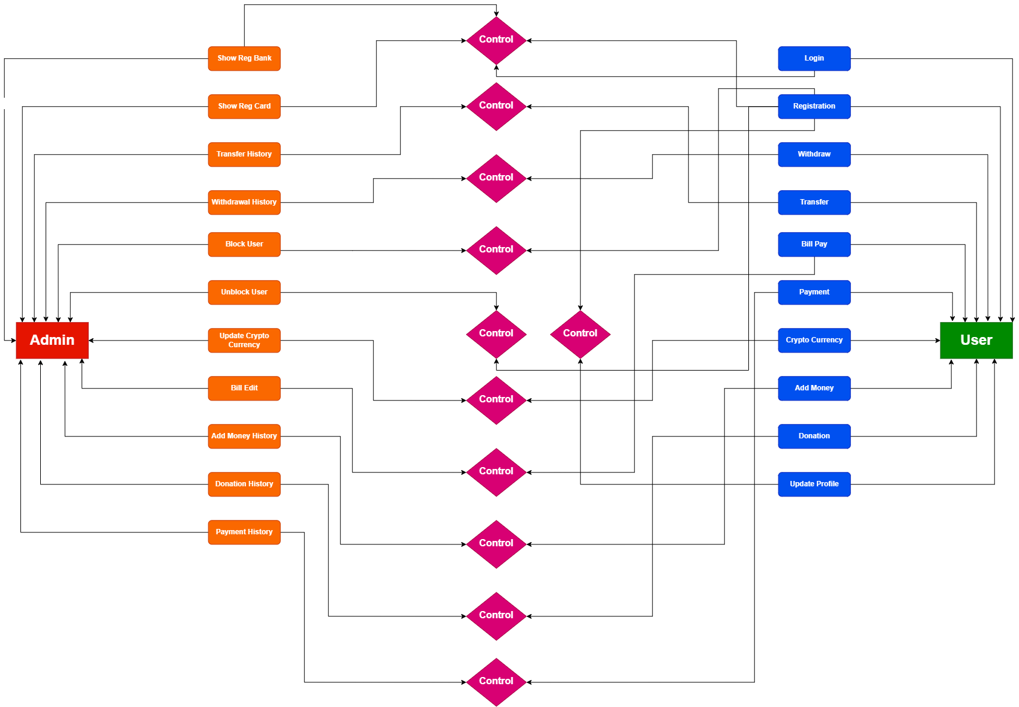
ER DIAGRAM

Slide 10
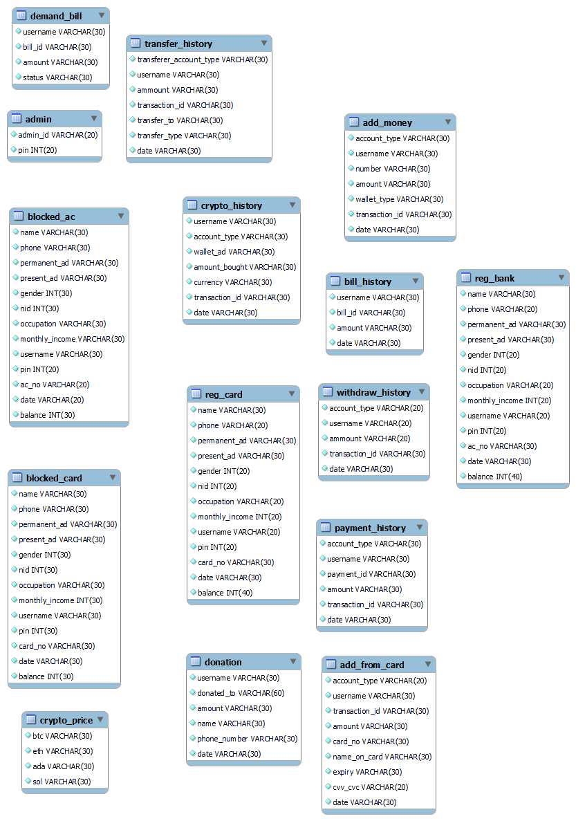
SCHEMA DIAGRAM

Slide 11
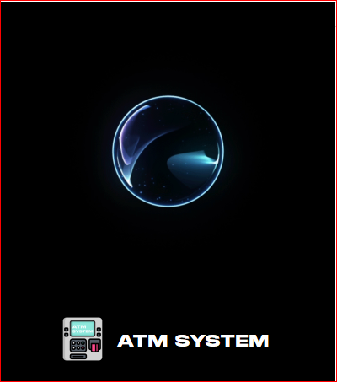
PROGRAM FEATURES
Login System
Manage All Transactions
Information efficiency
Record Users profile and admin profile
User Billing details
Add, Update & Delete all
Access users information easily
Advanced Search features
Manage Security

Slide 12
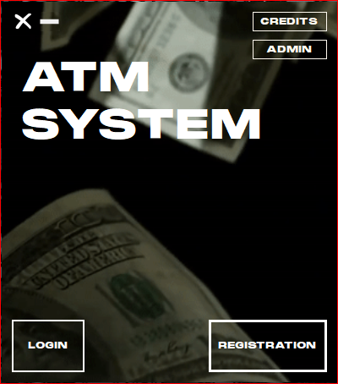
HOME PAGE
It’s an animated screen which will show at the time of open the software.
From here user and admin both will create account or login any registered account.

Slide 13
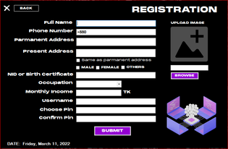
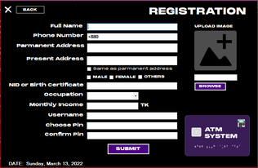
REGISTRATION FORM (BANK & CARD)
From the registration page, the admin and the user could create an account (bank acc or card) to give some personal information. Besides for backup, admin will show the whole info from the saved file in Database. After creating an account user will get 500 BDT in his/her account automatically.

Slide 14
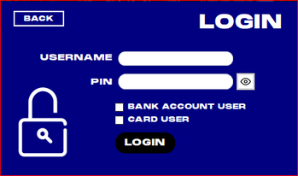
LOGIN CONSOLE
If user or admin give the fixed username and pin then they will enter the dashboard and also operate all transactions. But in case of any mismatched information get the software then it will show “incorrect info”.

Slide 15
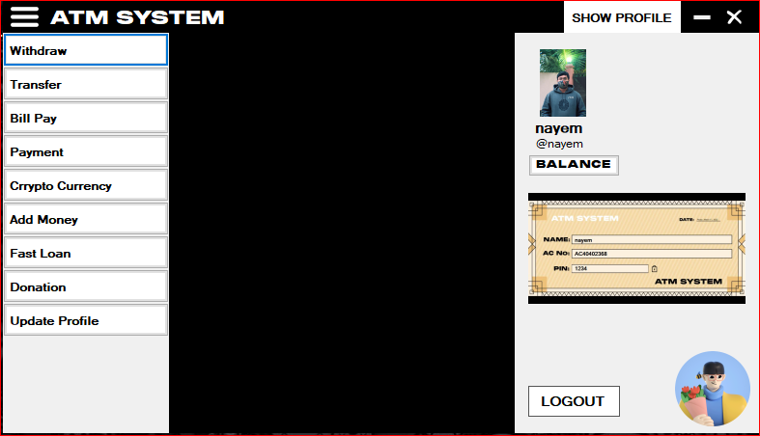
USER DASHBOARD
After login as user, you will get these options (withdraw, transfer, bill pay, payment, cryptocurrency, add money, fast loan, donation, update profile).

Slide 16
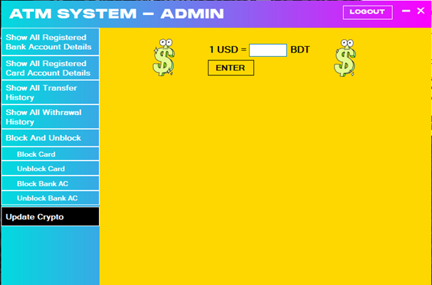
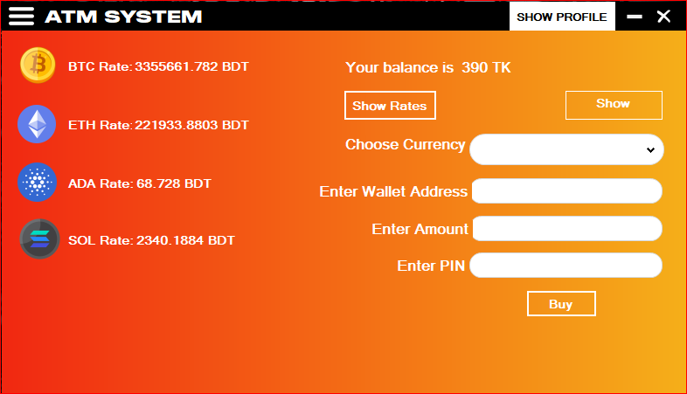
CRYPTOCURRENCY
The user could exchange and Buy cryptocurrency. The user will show the currency rate and also buy the currency from this software.
It’s the most important part of our project. From this option admin can change the rate of BTC, ETH, ADA and also SOL easily.

Slide 17
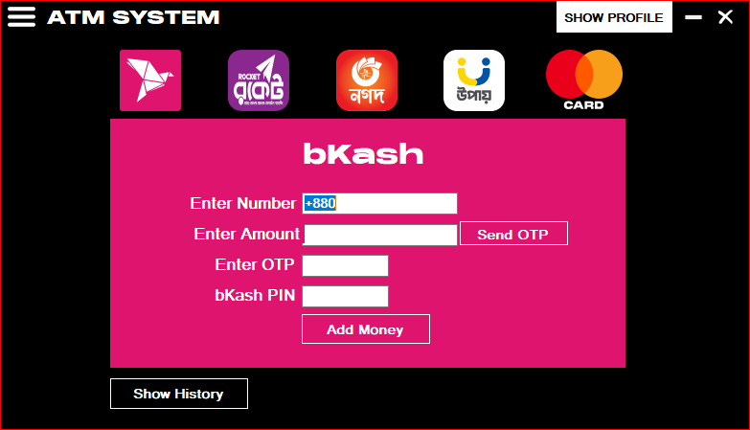
ADD MONEY
User can add money to his account from Bikash, Rocket, Nagad, Upay and also Card easily.
By sending an OTP(one time password) we will ensure the security, it will create randomly for each case.
Also they can see all transactions history if they want.

Slide 18
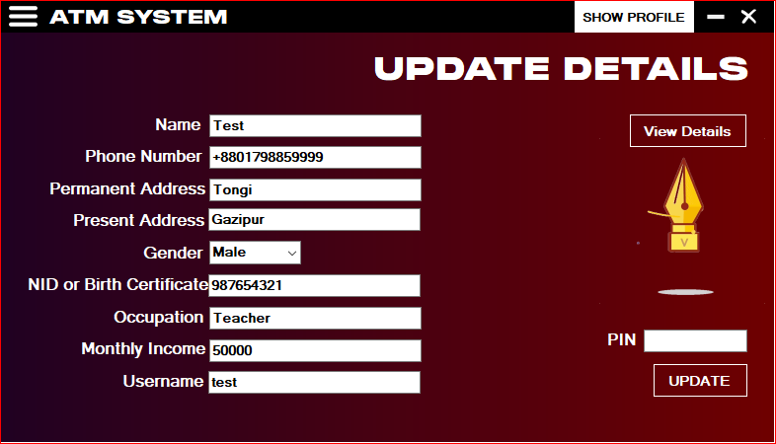
User can also update his/her profile. He can also change Pin and his user information
UPDATE PROFILE

Slide 19
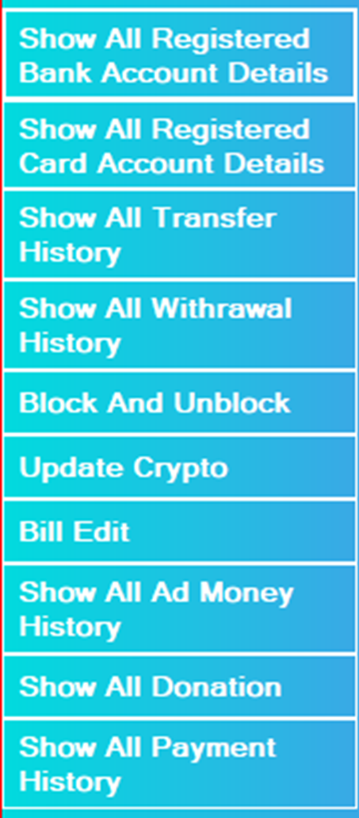
ADMIN PANEL
Admin can show all registered Bank and Card account details.
Show all transaction , all Withdrawal, add money, donation and payment history.
Admin can Create any Bill and send it user account also.
Admin can block any type of users and also unblock if needed.
Admin can update Crypto currency rate and also Show who can buy cryptocurrency.

Slide 20
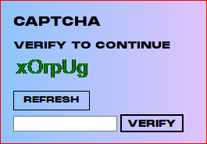
To verify admin have to maintain this Captcha.
Per refresh code will be changed.

Slide 21
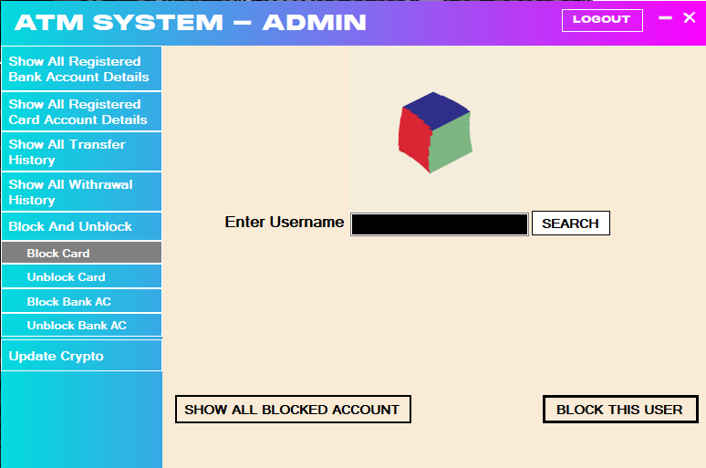
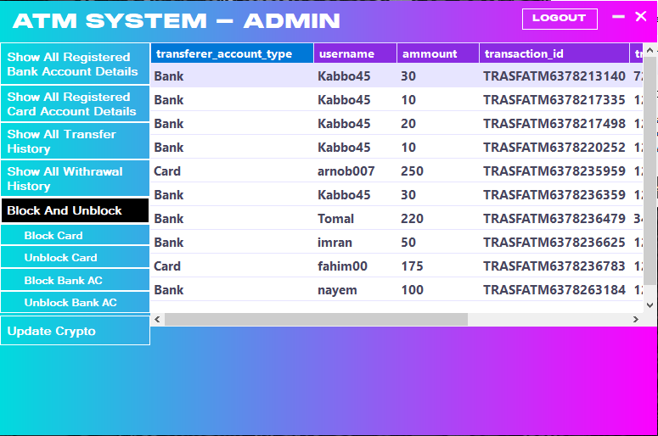
Admin can block any kind of bank and card account users and unblocking any account. The admin has the power to block the account user if the behavior of the account user is bad or aggressive.
BLOCKING & UNBLOCKING

Slide 22
FUTURE WORK
We want to make this software more user friendly.
We will an option for reporting bugs for fixing bugs (if any) or suggestions for better support.
We will add an option as “International Transfer System” for students if BUBT Authority allows us.

Slide 23
ADVANTAGES
International transaction
CryptoCurrency
Dual currency without passport
Easy transaction criteria
Portable

Slide 24
CONCLUSION
We were able to apply all those theoretical C# concepts taught to us in our application to make it more and more functional.
We learned to make the variables and constants either global or local.
The implementation of techniques like string comparison, function calling, recursion, array storage, using file for storage, and calling by value or reference has broaden my knowledge regarding C# language.
We made it more functional, compact and more user-friendly
Great security options
Helpful approach for users.

Slide 25
Is there any queries?
Feel free to question us

Slide 26
THANK YOU

